Slide 1
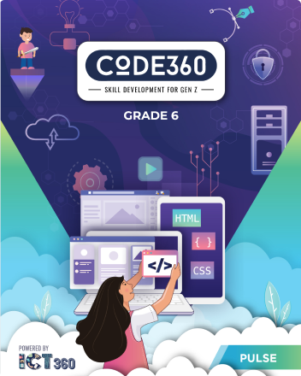
Mazen
Saad
Computer Teacher

Slide 2
ICT
Grade 6

Slide 3
Lesson title
Introduction to Web
The Date
2025 / /

Slide 4

What is World Wide Web?

Slide 5
The World Wide Web (WWW), commonly known as the Web, is a system where digital information is identified and accessed over the Internet

Slide 6

How to start creating websites

Slide 7

Enter the notebook and write the following:

